Slide 1


CSS Webkit

Slide 2

Topics
Introduction to CSS Webkit
Comparison between Standard CSS and Webkit CSS
Webkit Common Properties
Webkit example

Slide 3
Introduction to CSS Webkit
CSS Webkit is a CSS extension that is used by Webkit-based browsers, such as Safari and Google Chrome. Webkit is the rendering engine that powers these browsers, and CSS Webkit provides additional CSS properties that can be used to style web pages.
These extensions are generally prefixed with -webkit-.
Most -webkit- prefixed properties also work with an -apple- prefix.

Slide 4
Comparison between standard CSS and Webkit CSS
Standard CSS | Webkit CSS
CSS is a language used to style web pages. | WebKit is a rendering engine used by some web browsers, including Safari and Chrome.
Normal CSS, also known as standard CSS, is the set of styles that work in all modern browsers, including Firefox, Edge, and Chrome. | WebKit CSS, on the other hand, includes a set of properties and values that are specific to WebKit-based browsers, such as Safari and Chrome
It includes a large set of properties and values that are defined in the official CSS specifications. | These properties and values are not part of the official CSS specifications and may not work in other browsers.

Slide 5
Common Webkit Properties
-webkit-border-radius
-webkit-box-shadow
-webkit-transition
-webkit-transform
-webkit-overflow-scrolling

Slide 6
Example of Webkit
An example is the scrollbar property.
Standard CSS does not provide any way to style scrollbars, but WebKit-based browsers support a number of -webkit- properties that allow developers to customize the appearance of scrollbars on their web pages.
HTML
CSS
<body>
<div class="box"></div>
</body>
.box {
width: 100px;
height: 200vh;
background-color: blueviolet;
}
/* select the scroll bar and apply width*/
::-webkit-scrollbar {
width: 8px;
}
/* change the color of the scroll bar thumb*/
::-webkit-scrollbar-thumb {
background-color: #333;
border-radius: 2px;
}
/* change color of scrollbar thum on hover */
::-webkit-scrollbar-thumb:hover {
background-color: #555;
}

Slide 7
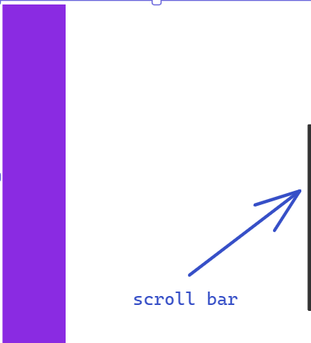
Example Output
Output

Slide 8
THANK YOU

